Slide 1
Door County Tourism Zone 2022 Annual Meeting

Slide 2
THE TOURISM ZONE… In May of 2007, 10 Communities formed a Tourism Zone according to WI State Statute 66.0615. By the end of 2008, all 19 communities were a part of the Door County Tourism Zone.
WHY AND WHEN…In 2007 the Door County Tourism Zone Commission was established via grass roots efforts by a group of concerned citizens called "Door County Peninsula Strategic Marketing Coalition“. They fundraised and volunteered their time to raise money for a market study. This idea didn’t originate with local government officials; it began with the very people who make their livelihood in the tourism and hospitality industry in Door County.
WHAT DID THE MARKET STUDY SHOW? Door County needed new revenue sources to create and implement effective marketing to stop losing tourism market share. Membership dues simply weren’t enough to effectuate a modern marketing program. For Door County to remain a sought-after destination, the only option was to generate money for a broad and unified marketing campaign.
TOURISM WORKS FOR US: HOW IS MARKETING PAID FOR? Room Tax revenue provides the mechanism that ensures the ongoing funding for the marketing of Door County. In the competitive marketplace where travelers have many options, Destination Marketing Funds allow Door County to be marketed and represented. Prior to 2007, Door County’s marketing entity, DDC, had marketed Door County with a marketing budget of less than $200,000.

Slide 3
Municipal Room Tax Distribution

Slide 4
Lodging Entity Functions
DOOR COUNTY TOURISM ZONE
Distributes 30% of room tax back to the municipality from which it was collected.
Operations are funded by municipalities.
Tracks all online lodging listings in Door County and ensures compliance.
Distributes 70% of room tax collected to Destination Door County, the designated marketing entity for Door County.
Is responsible for permitting, collections, distribution and enforcement of local room tax ordinances.
DESTINATION DOOR COUNTY
Receives 70% of room tax collected for funding operations as the designated marketing entity for Door County.
All remaining room tax revenues are used to market Door County to increase interest in visitor-ship and generate overnight stays.
Develops and executes their Annual Marketing plan and budget.
Reimburses municipalities for their portion of the DCTZC’s budget.
Distributes 19% of the 70% to the Strategic Community Partnership Program.

Slide 5
At year-end 2022, for the period of 2007-2022 the Tourism Zone has collected $71.9 million in room tax.
For the same period, the Tourism Zone distributed:
$47.9 million to Destination Door County.
$21.5 million to member municipalities.
Total Room Tax Revenue Through Year-End 2022

Slide 6
At year-end 2022, over $140 million in lodging revenue had been generated in Door County.
Total lodging revenues increased by 5.03% over 2021
Total Lodging Revenue

Slide 7
Room Tax Received By Municipalities

Slide 8
Collections By Municipality

Slide 9
Permits By Municipality

Slide 10
Permits By Property Type
Units By Property Type

Slide 11
Units By Municipality

Slide 12
Revenue By Property Type

Slide 13
ADR By Property Type

Slide 14
Occupancy By Property Type and Year

Slide 15
Tourism Zone Active Permits

Slide 16
2022 Year in Review
In 2022 the Tourism Zone successfully implements the room tax rate change across all permit holders.
The Commission and Destination Door County enter into a new Entity Agreement. TZC and DDC develop ongoing strategic marketing plan.
With support from DCTZC, DDC and the Door County Community Foundation establish the Community Investment Fund.
Recognizing the need for improved data access, staff implements a redesign of the Tourism Zone website.
The Commission makes a commitment to preserving resources by eliminating paper usage and transitioning to online filing. Staff host multiple education sessions to assist the transition.
The Commission reduces Commission liability and vulnerability by improving website security, and reassessing internal controls and duties.

Slide 17
Enforcement Measures/Successes-2022
The Tourism Zone recovered
$5,008.39 in legal fees
An additional $3,999 in legal fees were sent to collections
$51,197.30 in late fees and interest on unpaid tax
$35,886.77 in rejected ACH and credit card tax payments
$8,126.91 in tax payment shortages from incorrectly filed paper forms
Over 1,600 missing report letters and 1,000 emails were sent to permit holders ensuring compliance with reporting requirements, in addition to 400 incomplete/missing payment letters.
Of the two hundred twenty-eight properties permitted in 2022, Forty-three permits were issued due to compliance efforts (19%).
The Tourism Zone contracted with Hawkins Ash CPAs for the purpose of auditing a property manager and recovering $25,000 in missing taxes, fees, expenses, and penalties.
Three other judgments were made in the Commission's favor, totaling $19,887.64.

Slide 18
Legislative Changes
SB198/AB189
As of October 1, 2021, Marketplace Providers were no longer required to submit room tax and accompanying reports on a monthly basis. Taxes are now distributed on a quarterly basis.
The Tourism Zone office now monitors checks remitted on a quarterly basis compared to permit holder reports and the shortages/overages instead of monthly to reconcile any disparities.

Slide 19
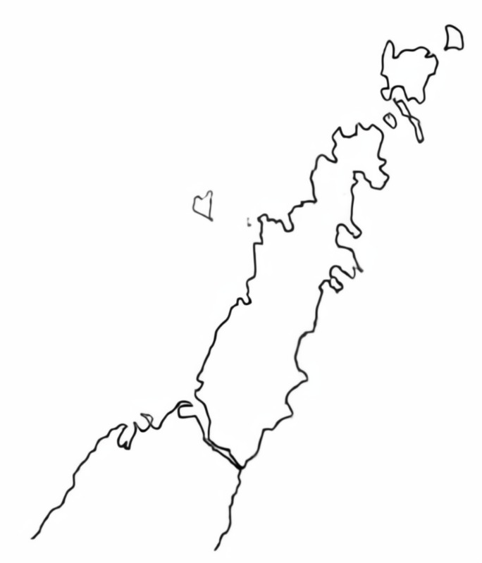
Looking Ahead in 2023
Assist the last of our permit holders in transitioning to online filing
Take measures to ensure continued room tax compliance and honest reporting throughout the County
Expand data availability to the public
Continue to assist and partner with requests, education, and partnership with permit holders and municipalities
Work to organize lodging tax entities
Continue to strengthen partner relationship with Destination Door County

Slide 20
2022 Tourism Zone Commission Annual Report

Slide 21
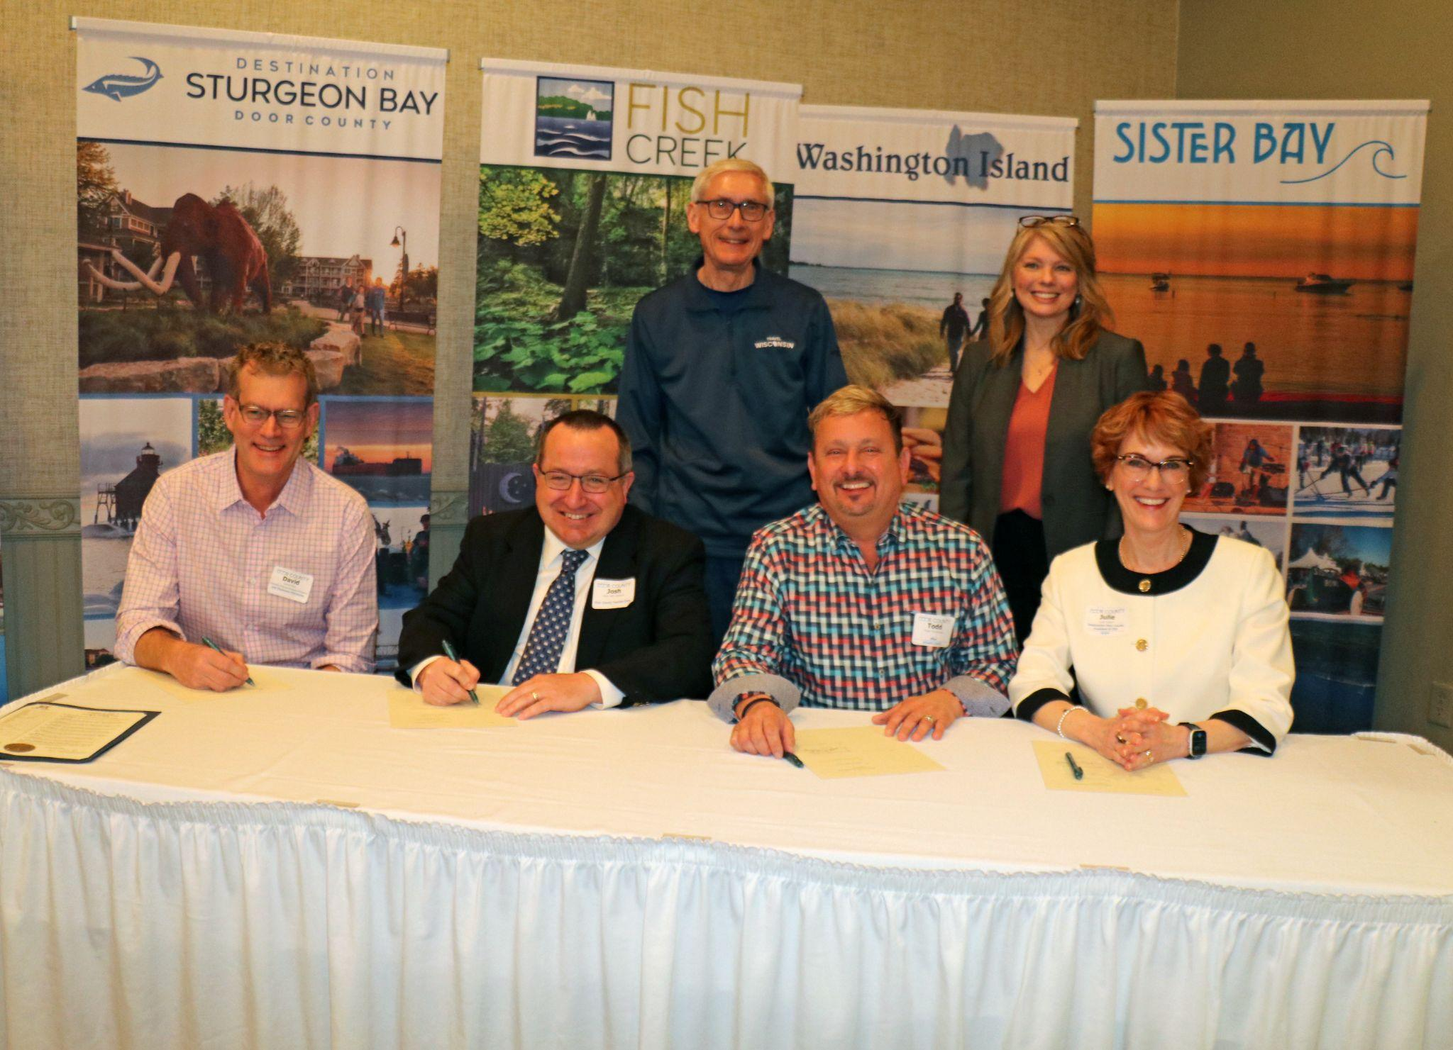
Industry Partnership Highlights
New entity agreement signed between DDC & DCTZC in May of 2022
New joint strategic planning committee convened to discuss and mutually agree on 2023 goals and objectives
Development of Community Investment Fund in preparation for 2023 program launch
New DDC Municipal Reimbursement Program established
An enhanced Strategic Community Partnership program began, providing an increase in funding to local Community Business Associations

Slide 22
Room Tax Accomplishments
Room tax continues to provide Door County a deeper reach into our regional markets and the
ability to work with media contacts and other influencers to receive regional & national coverage.
Media placement and PR took a multi-dimensional approach through a combination of advertising
mediums and public relations outreach which solidified our brand promise that “We will promote travel to Door County in a way that aims to minimize the environmental and social impact while maximizing economic impact. We strive to foster a local sense of place to ensure quality of life for residents that creates a positive impact on the county.”
Messaging was adjusted strategically throughout the year speaking directly to both visitors and
residents.

Slide 23
Room Tax Accomplishments
In 2022 we continued to leverage our Care for Door County initiatives by promoting the Door County Pledge and hosted several Leave No Trace Tuesday events across the county
DoorCounty.com had almost 2 million visits (Google Analytics).
We’ve hosted 1,153 travel journalists from 2007 through 2022, which has resulted in 2,699 published articles and stories about Door County thus far and reached an audience of nearly 8.9 billion readers/listeners/viewers.

Slide 24
Economic Impact of Tourism in Door County - 2022
$582 million generated in total economic impact from the visitor economy (Direct + Indirect + Induced)
$467 million generated in direct tourism spending
$47.8 million generated in local & state taxes
3,335 local jobs supported by tourism
$113.3 million in total labor income from tourism
Support to local lodging, restaurants, retail and attractions….enhancing the quality of life for residents
Source: Tourism Economics

Slide 25
Primary Results: Visitor Spending in 2022
 | Total Economic Impact |  |  | Direct Visitor Spending
 | Amount |  | % | Amount |  | %
 | 2021 | 2022 | Change | 2021 | 2022 | Change
Wisconsin | $20.9 billion | $23.7 billion | 13.0% | $12.9 billion | $14.9 billion | 15.7%
Door County | $530.7 million | $582.4 million | 9.7% | $423.1 million | $466.5 million | 10.3%
Source: Tourism Economics

Slide 26
Primary Results: Visitor Economy Impact in 2022
 | Employment |  |  | Total Labor Income |  |  | State and Local Taxes
 | Total |  | % | Millions |  | % | Millions |  | %
 | 2021 | 2022 | Change | 2021 | 2022 | Change | 2021 | 2022 | Change
Wisconsin | 169,707 | 174,623 | 2.9% | $5,798.3 | $6,525.7 | 12.5% | $1,388.2 | $1,516.2 | 9.2%
Door County | 3,321 | 3,335 | 0.4% | $102.5 | $113.3 | 10.5% | $42.7 | $50.7 | 18.6%
Source: Tourism Economics

Slide 27
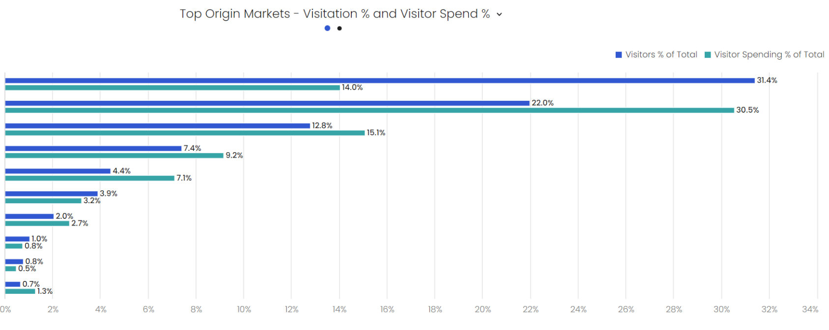
Primary Results: 2022 Visitation & Spend by DMA
Green Bay - Appleton, WI
Milwaukee, WI
Chicago, IL
Madison, WI
Minneapolis - St. Paul, MN
Wausau - Rhinelander, WI
La Crosse - Eau Claire, WI
Rockford, IL
St. Louis, MO
Davenport, IA/Moline, IL
Source: Near/Affinity

Slide 28
Primary Results: Seasonal Distribution
2021
2022
Source: Near

Slide 29
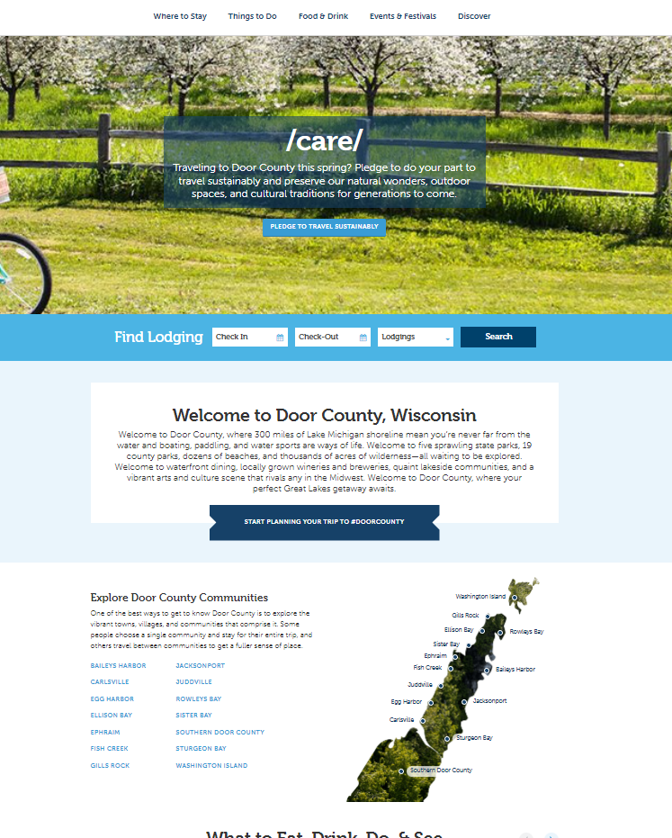
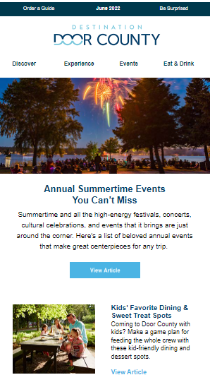
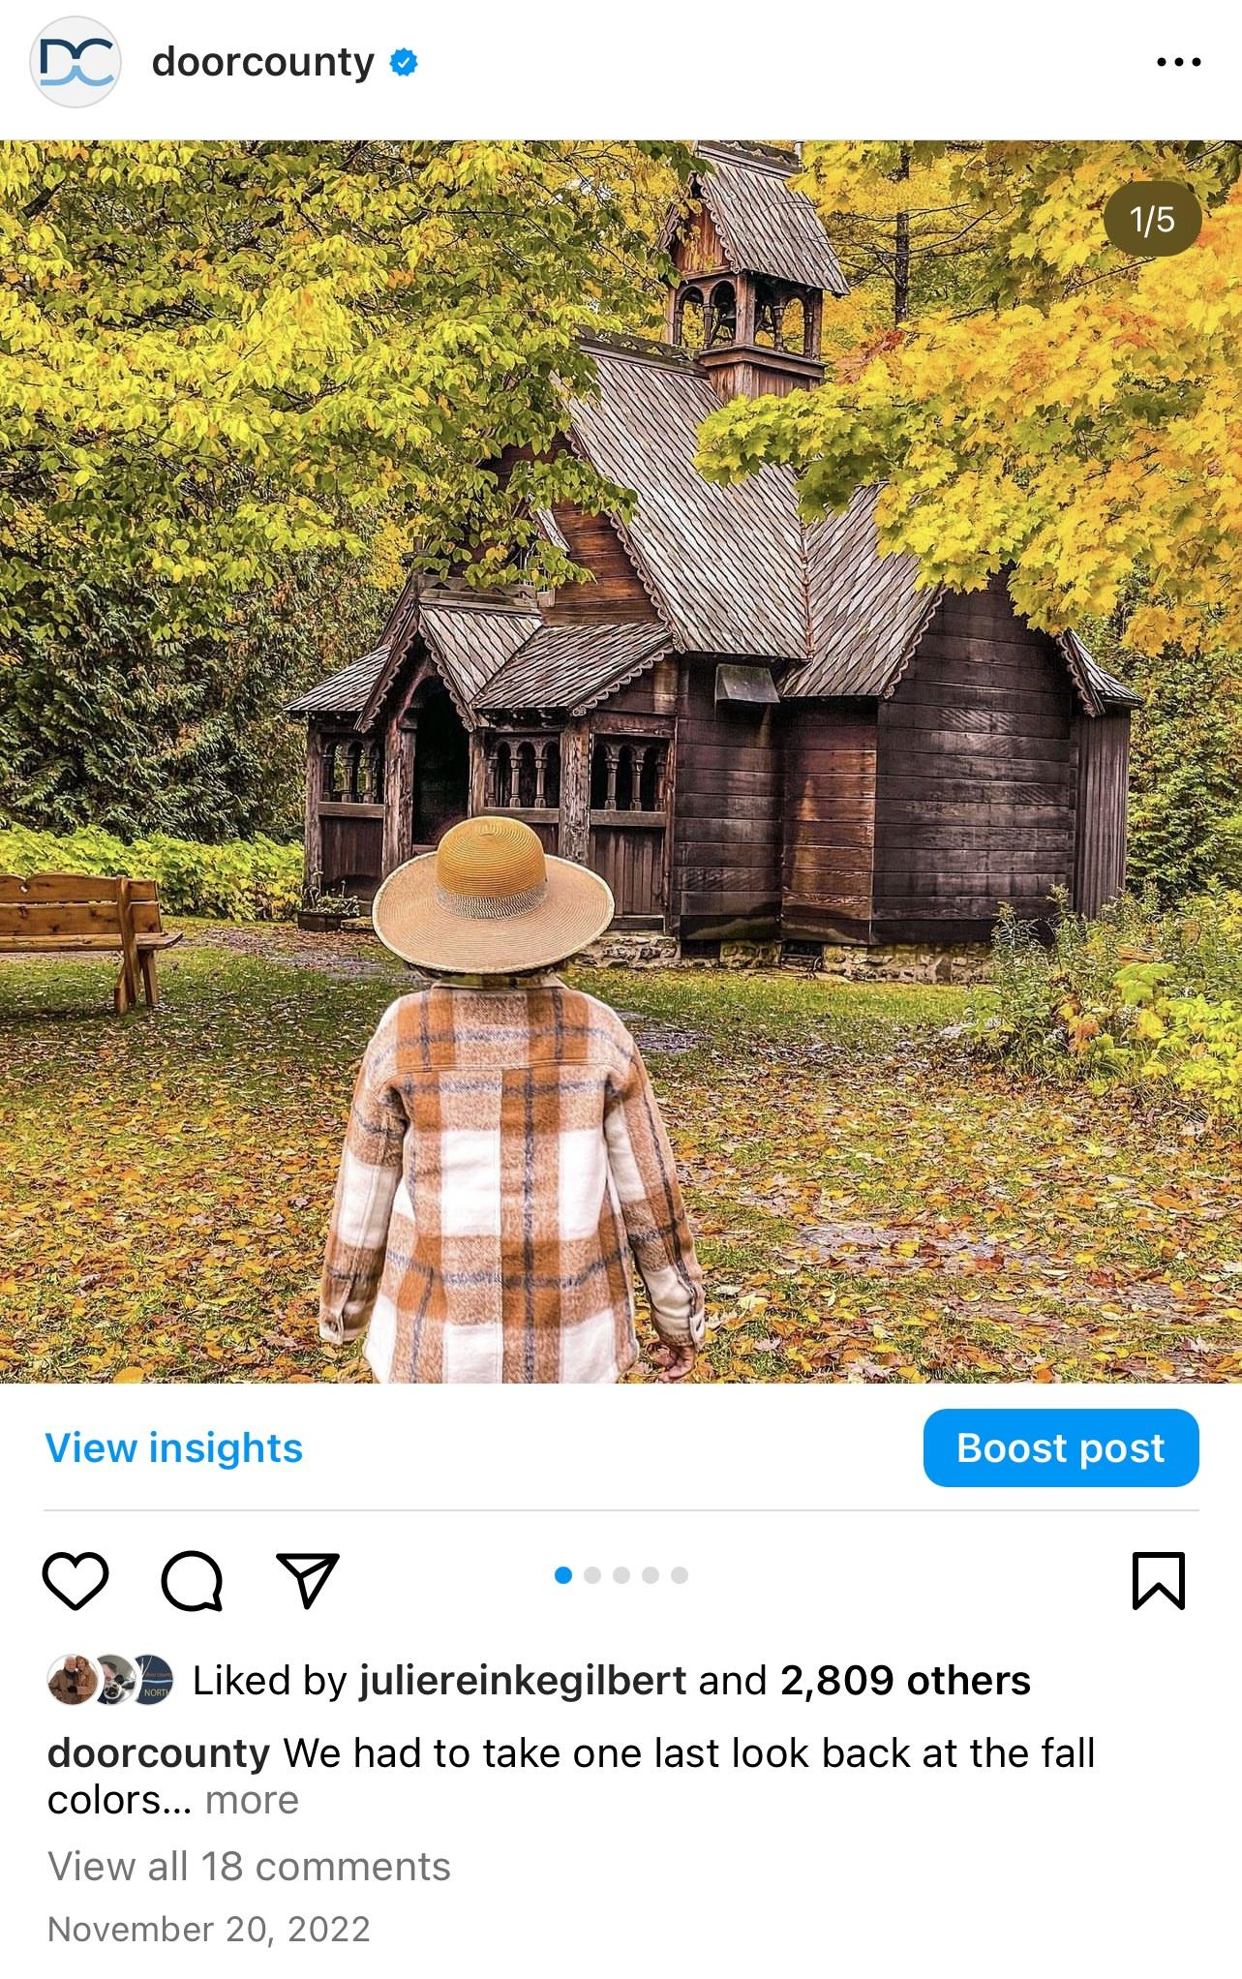
Owned Media Results
DoorCounty.com
1.83 million visitors to site
197,484 searches for lodging through Book Direct
Migration to new CMS (Kentico) in July
Implemented 9 conversion goals on site
eNewsletter
Average monthly subscribers: 226K
Average open rate: 44.68% (benchmark 20.44%)
Average click rate/engagement: 3.58% (benchmark 2.25%)
Social Media
Total Impressions: 9.7 million (Facebook, Instagram, Twitter)
Total Audience Engagement: 243.3K
6 Giveaway campaigns - total 2.5K new followers
Promoted 25 DDC partner businesses through c0-op advertising

Slide 30
Paid Media Results
Total Impressions: 68 million
Paid Traffic: 593K users to DoorCounty.com
Ad placement included:
Digital interactive (seasonal, workforce recruitment)
Paid social (general leisure, wedding, lead gen)
Google Adwords
Digital billboards
Video
Audio (Pandora)
Key Markets: Green Bay/Appleton, Milwaukee, Chicago, Madison, Minneapolis/St. Paul and Door County

Slide 31
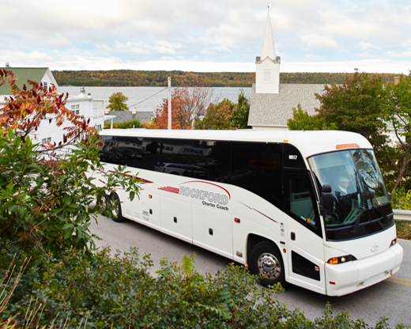
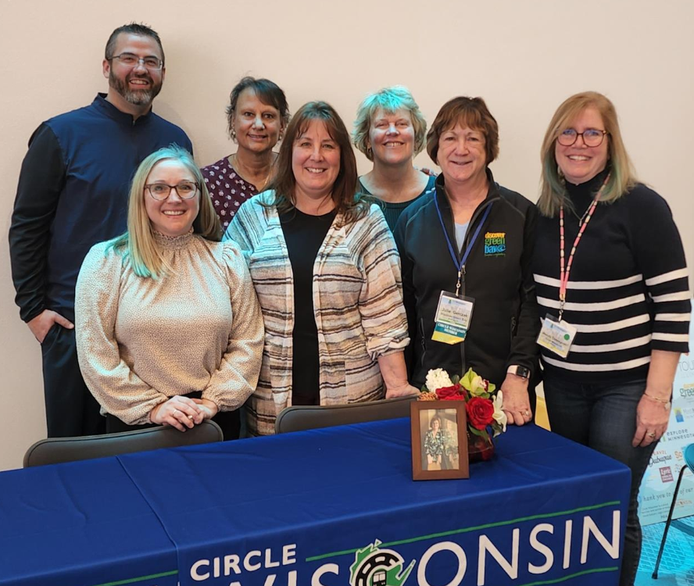
Meeting & Group Sales
Group and Meeting Site Views: 13,346
Shows Attended: American Bus Association (Grapevine, TX), Midwest Marketplace (Bloomington, MN), IPW (Orlando, FL)
Represented Door County and provided group market updates to 100+ tour operators & travel buyers
Continued membership with Circle Wisconsin and volunteer position on Board of Directors

Slide 32
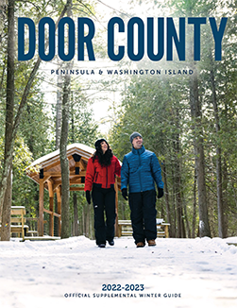
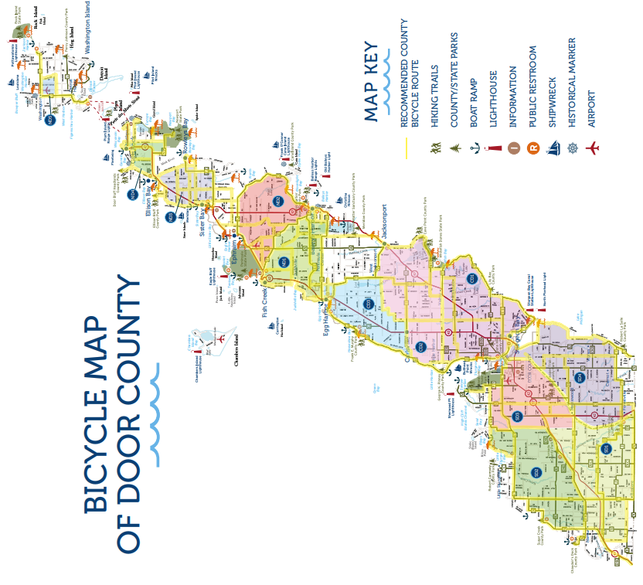
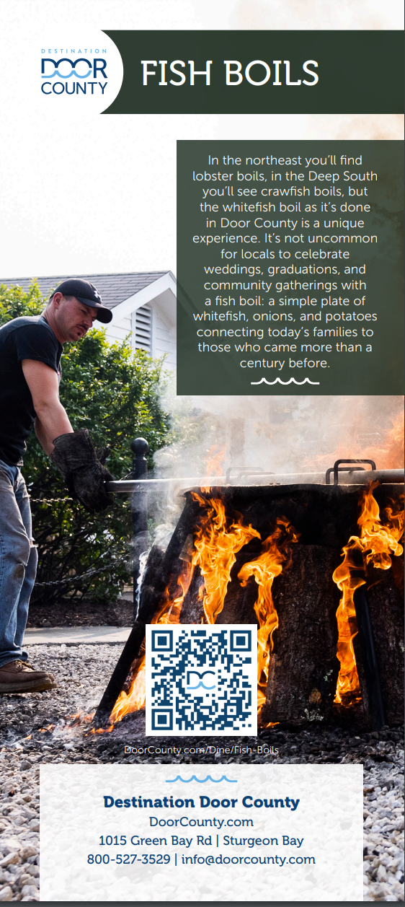
Publications
Official Destination Guide
Supplemental Winter Guide
Niche Brochures
County Map
Bike Map
Fish Boils
Wineries, Breweries Distilleries & Cider Houses
Orchards & Farm Markets
Family Fun
Birding Guide
Emergency Card
Leave No Trace
Water Sports
Lighthouses

Slide 33
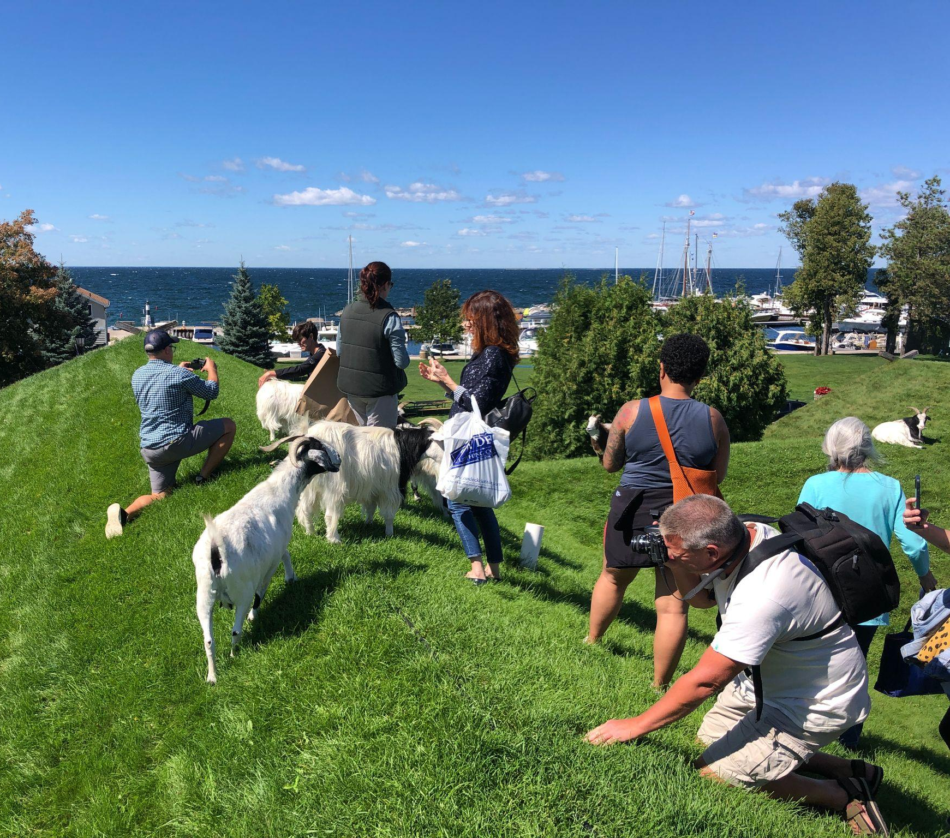
Communications & Advocacy
Public Relations Highlights
Hosted 71 journalists during 7 themed press trips between February & December in 2022
257 articles and stories were reported as a result of our PR efforts
$6,653,211 in earned media value (measured in terms of ad value equivalency)
4,472,141,555 impressions were generated through the resulting media coverage

Slide 34
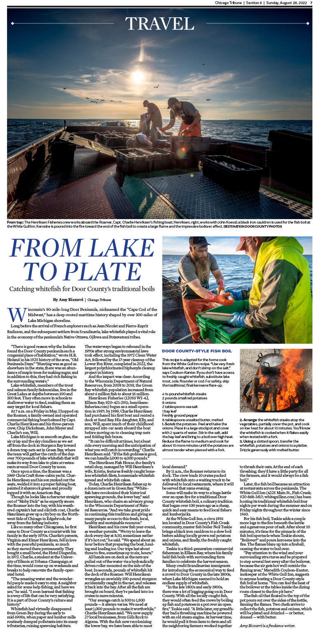
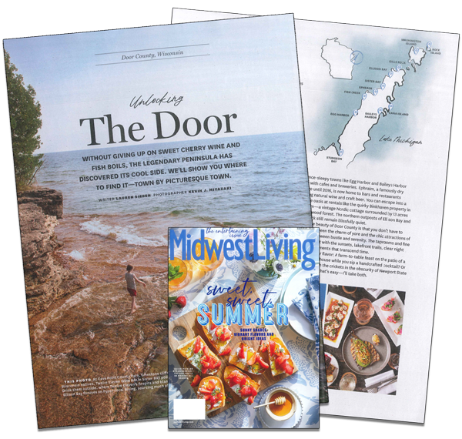
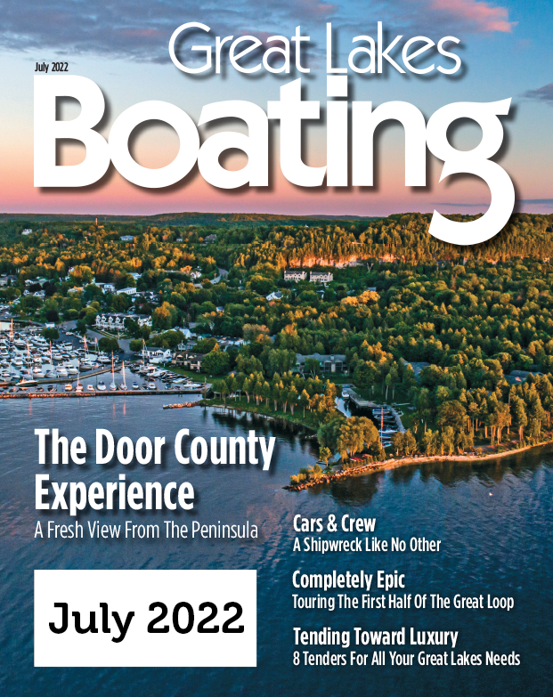
Communications & Advocacy
2022 Article Highlights

Slide 35
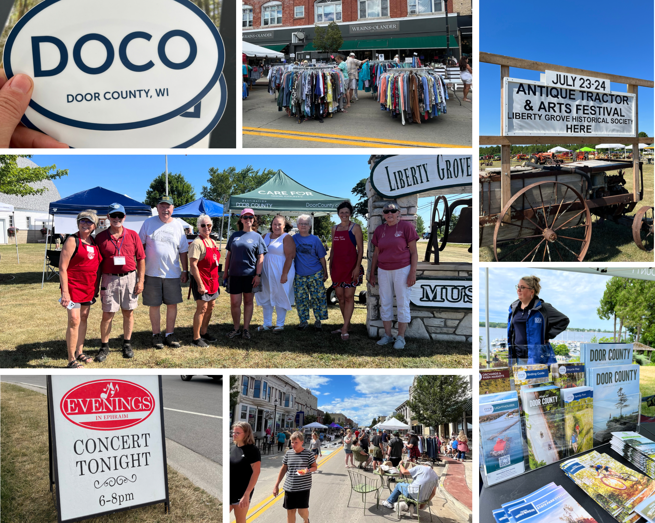
Communications & Advocacy
Community Engagement
Hosted 10 activations in 8 different communities in 2022
Helped sponsor Door County History Days and supported local organizations in playbills and other support materials
Continued our partnership with Leave No Trace and worked behind-the-scenes on projects that will come to fruition in 2023

Slide 36
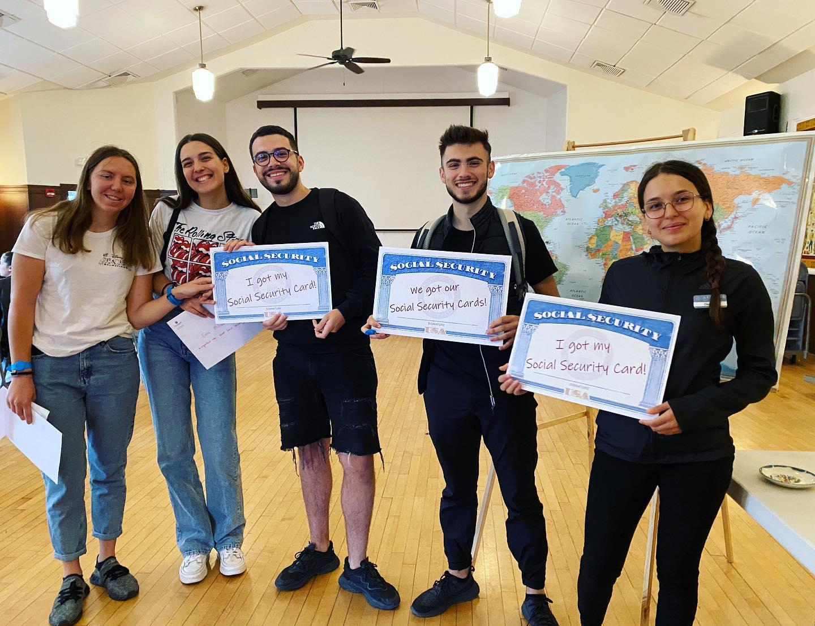
Communications & Advocacy
Industry/Partner Support
Helped welcome and support 497 J-1 students that worked in Door County in 2022
Assisted 48 local businesses by helping their J-1 students get Social Security cards in Door County
Provided workforce assistance for job seekers and employers through JobsInDoorCounty.com

Slide 37
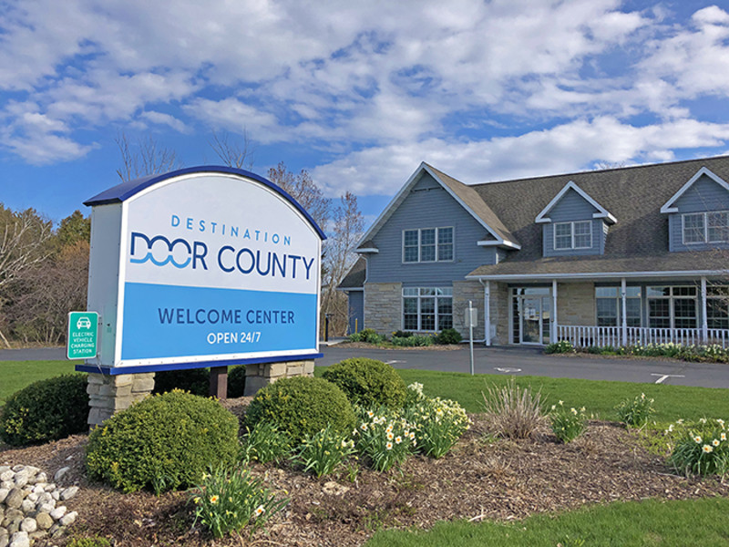
Welcome Center
$713,995 Gift Certificate Sales
26,718 Visitors to the Welcome Center
24,469 Destination Guide Requests
1015 Green Bay Rd - Sturgeon Bay, WI

Slide 38
Looking Ahead
Community Outreach & Destination Alignment
GOAL #1 ​
Cultivate an environment where Door County’s tourism industry can lead by example, championing tourism’s benefits, helping mitigate its impacts and connecting the community to its regenerative capabilities.​
GOAL #2
Foster our local spirit, our values, our sense of place, and the wellbeing of our community – residents, employers, employees, and visitors alike.​
OBJECTIVES​
Invest in unified community messaging to highlight demands and opportunities of the visitor economy ​
Increase residential awareness on the benefits of tourism​
Amplify community and industry partnerships to strengthen destination product offerings​ and foster entrepreneurial development
Collaborate with local stakeholders and organizations to align mutual interests and harness the passion people have for Door County to help make it an even better place

Slide 39
Sustainability
OBJECTIVES​
Work with groups, organizations and local government to advocate for investments which preserve the shore, land and forests and encourage responsible development​
Maximize environmental resources to help maintain essential ecosystems and conserve biodiversity​​
Accentuate tourism’s benefits and pursue the reduction of tourism’s negative impacts​​
Support the wellbeing of our people and local culture
GOAL #1 ​
Nurture social, cultural and economic resilience for a more sustainable, balanced and equitable visitor economy.​
GOAL #2​
Advocate for the preservation and protection of our environment and natural resources.​

Slide 40
Values Based Marketing
OBJECTIVES​​
Create incremental growth for the local economy by promoting, developing, and expanding a united visitor industry​
Initiate flexible, targeted promotions that address visitor capacity, dispersing visitation and economic impact, while focusing on visitor passions and market research/trends​​
Develop and execute integrated marketing, communications, sales, and research efforts that will generate revenues and economic benefits for Door County​​
Tell authentic, honest stories that accurately reflect both the past and present, intersecting our community’s identities, cultures and shared values
GOAL #1​
Be bold, creative, and action-focused, supporting transparency and measurable outcomes.​
GOAL #2​
Encourage stewardship by elevating Door County and its communities’ authentic character, creative energy, and brand.

Slide 41
THANK YOU!

